Slide 1
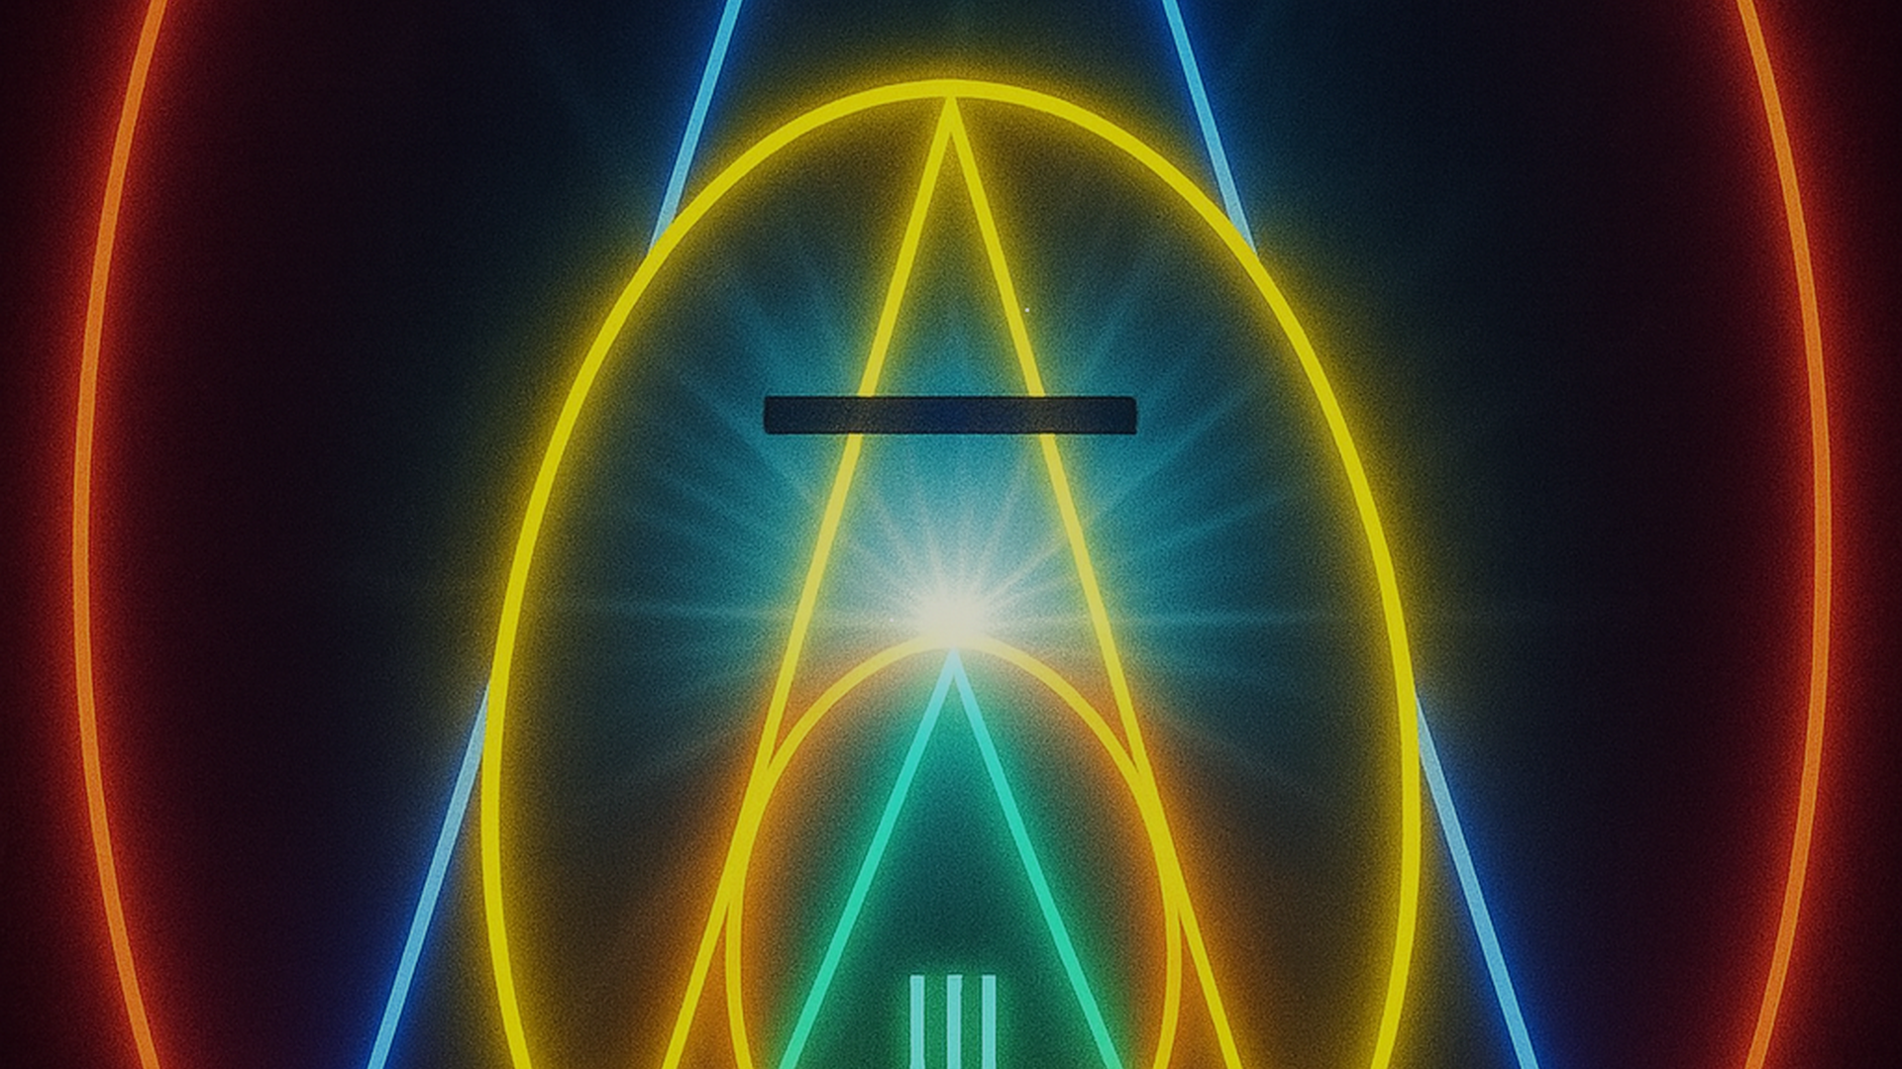
VISUAL DECOMPOSITION
Neon Emblem
Slides
Built from the uploaded luminous symbol: circles, triangles, numerals I · II · IV.
NEON EMBLEM / uploaded image study
01/08

Slide 2

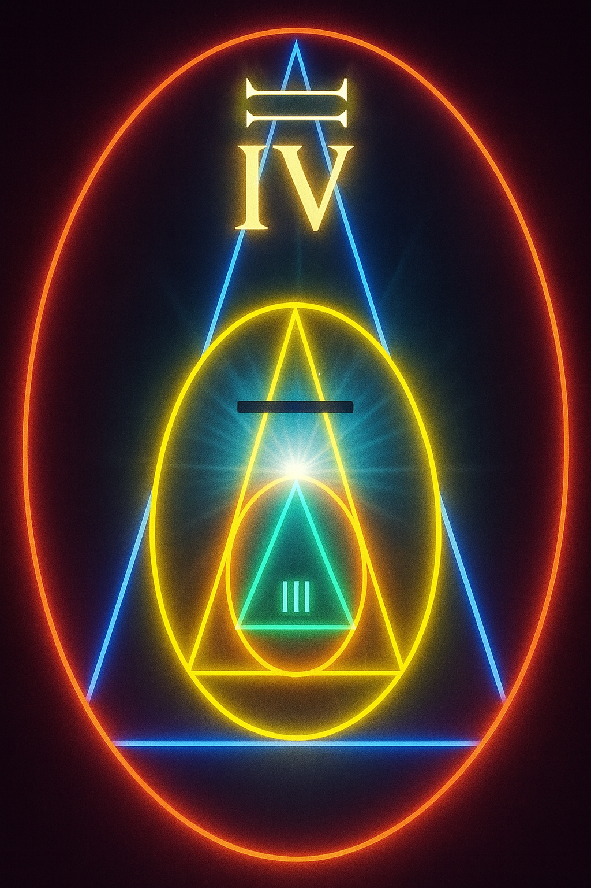
01 / OVERVIEW
What the image shows
A stacked neon diagram: one outer ring, one large triangle, one middle ring, one smaller triangle, and a bright central flare.
Outer field: Large red-orange double ring enclosing the whole mark.
Large triangle: Blue neon triangle points upward, framing the top numeral IV.
Middle set: Yellow circle + triangle form the main body around the dark horizontal bar.
Inner set: Green small circle + triangle sit near the lower center with II.
Light core: White-cyan flare sits where the nested axes meet.
NEON EMBLEM / uploaded image study
02/08

Slide 3

02 / GEOMETRY
Nested order, read from outside in
The composition is basically a target/mandala: ring → triangle → ring → triangle → flare.
1
Outer red-orange ring: boundary / enclosure
2
Blue upward triangle: ascent / frame
3
Yellow circle + triangle: main body / emphasis
4
Green circle + triangle: inner chamber
5
White-cyan flare: focal point / energy
Schematic recreation — not exact trace
NEON EMBLEM / uploaded image study
03/08

Slide 4
03 / SIGNS
Numerals and the lone bar
Visible signs: IV at the top, II near the bottom, and a dark horizontal stroke across the yellow triangle.
IV
—
II
TOP REGISTER
MIDDLE REGISTER
LOWER REGISTER
Placed inside the blue triangle, just under the apex; reads as a high/outer value.
A short dark horizontal bar interrupts the yellow triangle; exact meaning is not determinable from the image alone.
Placed inside the small green chamber; reads as a lower/inner value.
Honest note: the numerals may be ordinal, decorative, or symbolic; without source context, treat interpretations as hypotheses.
NEON EMBLEM / uploaded image study
04/08

Slide 5
04 / COLOR + LIGHT
Sampled neon palette
Approximate hex values sampled from the glow; use them as accents rather than large flat fills.
Lighting recipe
Base: near-black indigo (#03050C)
#FF3B24
#FF8A00
#FFE45C
Key glow: white-cyan core
signal red
hot orange
lamp yellow
Secondary: yellow/green mid rings
Outer heat: red-orange rim
Rule: pair neon with 70–85% dark space
#46FFB4
#4DA3FF
#F4FBFF
mint green
electric blue
flare white
NEON EMBLEM / uploaded image study
05/08

Slide 6
05 / MEANING
Four lenses, one caveat
The image supports several readings; none is confirmed unless you share where it came from.
Alchemical / occult
Sacred geometry
Circles + triangles + numerals evoke elemental diagrams and initiatory emblems. Treat as mood, not evidence.
Concentric nesting and an upward triangle suggest axis, order, and convergence toward a center.
Design / brand
Narrative device
A ready-made sigil: strong silhouette, glow palette, and clear focal point for music, gaming, or tech.
Can act as a map: IV outside/top, II inside/bottom, with the bar marking a threshold or seal.
NEON EMBLEM / uploaded image study
06/08

Slide 7
06 / PUT IT TO WORK
Slide-ready directions
Use the symbol as a visual anchor, then let dark space and one neon accent carry each slide.
Deck moves
Next options
Title slide: Full-bleed image, small title panel.
If you want edits: I can rebuild this as a stricter minimal deck, a dark conference template, or a pitch-deck version.
Chapter divider: One numeral per slide: I / II / IV.
If you want context: Tell me the source or intended meaning, and I’ll align titles/claims accordingly.
Concept slide: Keep one idea beside the glow; avoid clutter.
If you want assets: I can also extract a transparent PNG-style emblem approximation (background removal is approximate due glow).
Closing slide: Return to full emblem for a strong final beat.
NEON EMBLEM / uploaded image study
07/08

Slide 8
Appendix — original uploaded image (213.png)
NEON EMBLEM / uploaded image study
08/08

